Slide 1
Launch of two new decision frameworks
Midnight Poonkasetwattana (APCOM) &
Kevin Osborne (International AIDS Society)
It’s time to test and treat differently
Notes:
MIDNIGHT - This morning, Kevin and I will officially launch two new decision frameworks.

Slide 2
Building on the success of…
Notes:
MIDNIGHT - These frameworks are part of a series. The first decision framework was launched two years ago in Durban at AIDS 2016 and focused on differentiated ART delivery. Following this, the second framework focused on differentiated ART delivery for children, adolescents, pregnant and breastfeeding women.

Slide 3
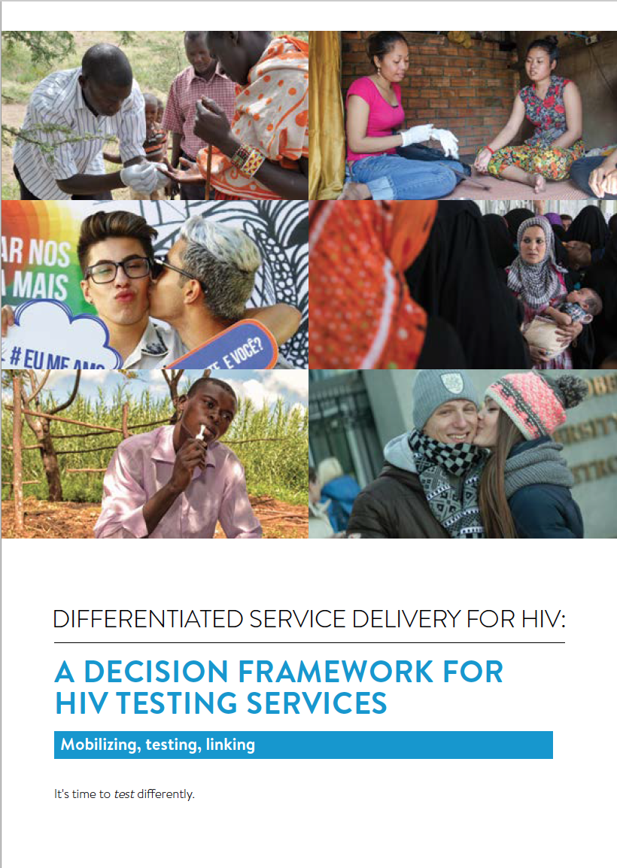
DIFFERENTIATED SERVICE DELIVERY FOR HIV: A DECISION FRAMEWORK FOR HIV TESTING SERVICES
Highlights how the principles of
DSD may support a systematic approach to reaching the remaining people living with HIV who do not know their status
Notes:
MIDNIGHT - I am excited to share with you “A decision framework for HIV testing services”. As part of the Technical Working Group who developed this document, this has been developed for national and district programme managers as well as implementing partners, donors and other organizations supporting national HIV programmes. It builds on the momentum around differentiated service delivery and acknowledges that while HIV testing as always in some way been differentiated, we are now shifting towards approaches that will maximize the identification of HIV positive diagnoses.

Slide 4
Differentiated service delivery is applicable across the HIV care continuum
Notes:
MIDNIGHT - Differentiated service delivery has received a lot of attention, but this has primarily been focused on the second and the third 90, and on high prevalence contexts. This decision framework focuses on the first 90 – and what service delivery models are going to increase the number of people living with HIV who know their status and improve linkage to both ART and prevention.

Slide 5
Building blocks for mobilizing, testing and linking
Notes:
MIDNIGHT - The framework emphasizes the concepts of the building blocks – and how for each HIV testing model, these are needed for mobilizing, testing and linking. In other words, it takes the principles described for ART delivery and applies them to testing.

Slide 6
Follow these characters as they find solutions to common challenges in HIV care
Notes:
MIDNIGHT - Common challenges are highlighted throughout by following characters who express concerns around HIV testing – and then how through a differentiated service delivery approach, find resolutions to these challenges. We look forward to hearing from you on how this framework may be applied in your work and in your country.

Slide 7
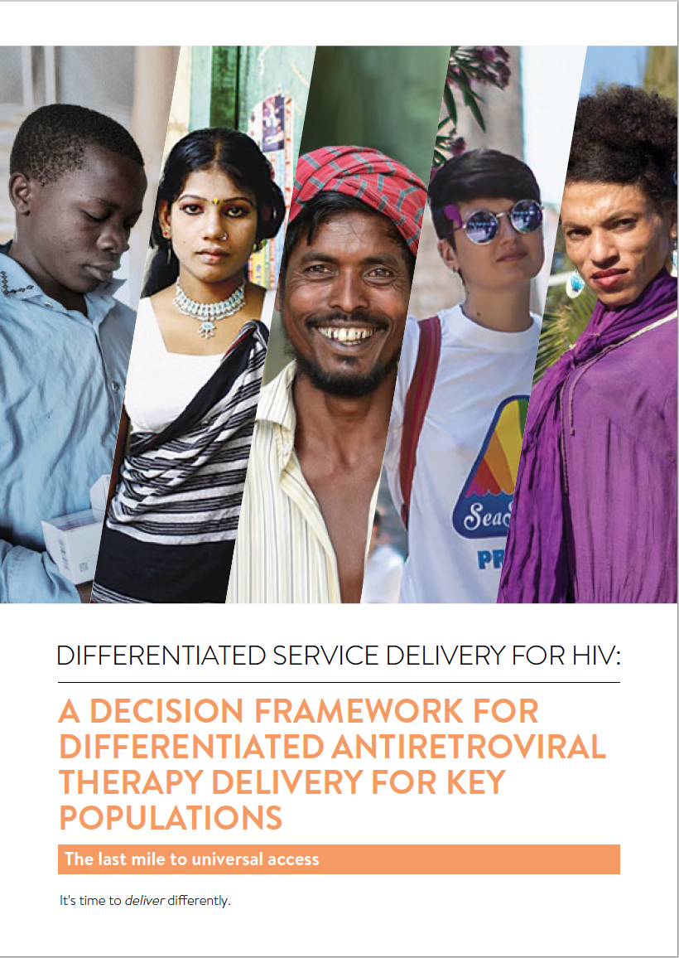
DIFFERENTIATED SERVICE DELIVERY FOR HIV: A DECISION FRAMEWORK FOR ANTIRETROVIRAL THERAPY FOR KEY POPULATIONS
Focuses on four groups: men who have sex with men, people who use drugs, transgender people and sex workers
1. Can you adapt an existing HIV or health intervention for key populations?
2. Can you leverage an existing key population intervention to include differentiated ART delivery
Notes:
KEVIN - I’m also very happy to today launch A decision framework for differentiated ART delivery for key populations. This decision framework builds on the 2016 and 2017 decision frameworks mentioned by Midnight. It’s a “how to” guide – providing guidance on how to implement the WHO recommendations for ART and the 2017 key considerations. It’s also an advocacy tool that focuses on improving the quality of treatment services for men who have sex with men, people who inject drugs, transgender people and sex workers.

Slide 8
Highlights examples and case studies from around the world
More details on female sex-worker led CCLADs in Uganda and KPLHS from Thailand as presented
Community-based ART delivery for people who inject drugs from India
Integration of ART delivery into KP services from Haiti
Data to be shared at AIDS 2018 including the decentralization of HIV care for men who have sex with men in Guatemala City, same day ART initiation in Tanzania and leveraging of drop-in centres to provide ART refills
Notes:
KEVIN - This decision framework draws on experiences and best practices from around the world. While previous decision frameworks have focused primarily on sub-Saharan Africa, this framework is regionally diverse. In addition to details of the models in Thailand and Uganda that have been already presented, there are examples of community-based ART delivery for people who inject drugs in India and on the integration of ART delivery into key populations services from Haiti.

Slide 9
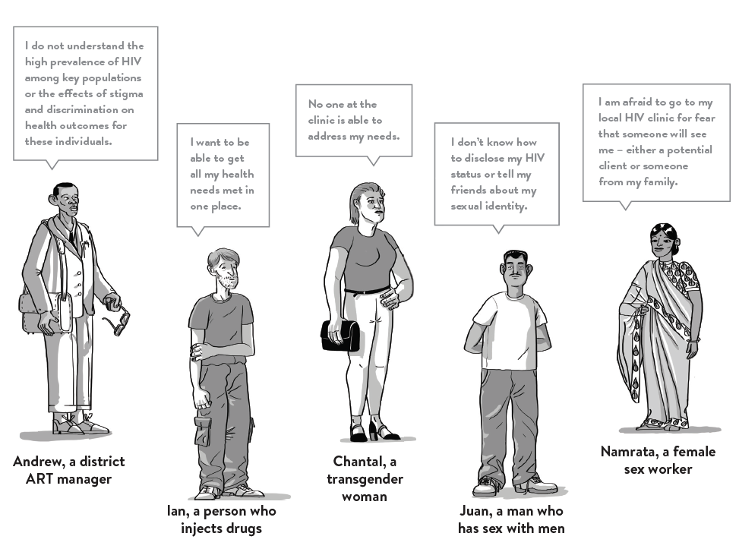
Follow these characters as they find solutions to common challenges in HIV care
Notes:
KEVIN - We also follow the stories of Andrew, the district ART manager but also Ian, Chantal, Juan and Namrata. These characters bring to life some of the common challenges faced by key populations accessing HIV services. While the focus is on ART delivery, these characters and the case studies highlight the critical role of key population peers in the provision of services, the role of community based services and the opportunity to leverage existing key population organizations to support access to ART.

Slide 10
Special thanks
The decision frameworks are developed through a consultative and collaborative process – thank you to those who provided guidance, feedback and support during the development.
Notes:
KEVIN - All of the decision frameworks are brand neutral, designed to be utilized within countries by HIV programme managers and are the result of collaborative and collective work among many agencies. We thank all the partners organizations and individuals who have contributed to the development of these frameworks.

Slide 11
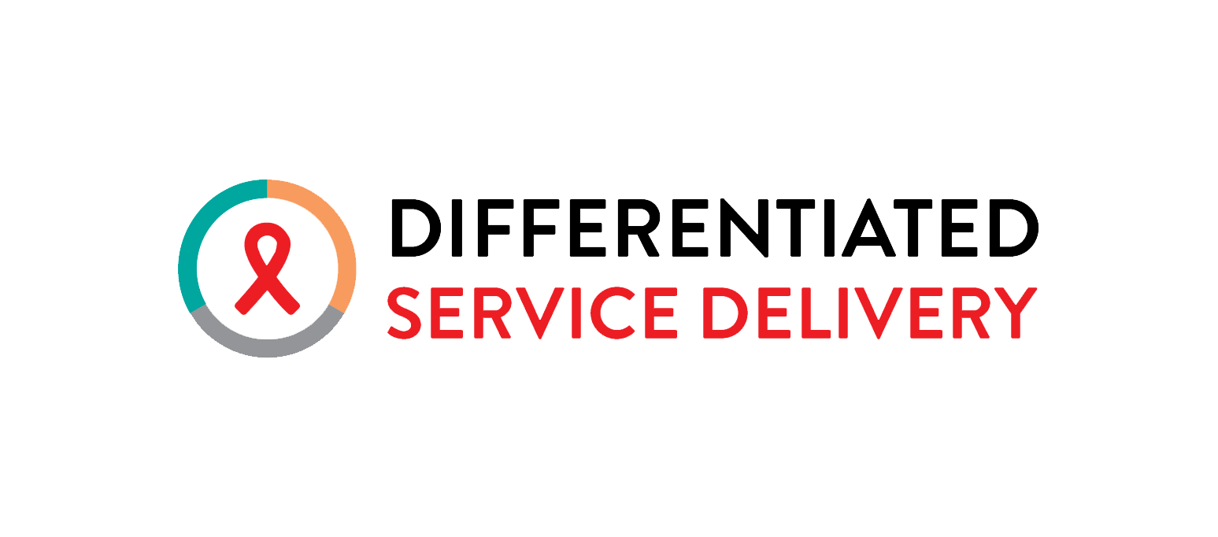
Visit www.differentiatedservicedelivery.org
to download the decision framework series
Notes:
KEVIN - In addition to the hardcopies available to you today, we also welcome you to visit www.differentiatedservicedelivery.org to download the decision frameworks series in addition to other tools and resources to support the scale-up and implementation of differentiated service delivery.
To end, I’ll leave you with this call to action: It’s time to test and treat differently for everybody, including key populations.
Thank you.

